Slide 1
Introduction to Spatial Analysis in R BOLDER Africa Gap Analysis Workshop
Wanjiku Githu
b.wanjiku@cgiar.org
January 28, 2025
Cali, Colombia
Time: 2 hrs 30 mins

Slide 2
Overview
Introduction
Spatial data formats
Important spatial concepts
Basic spatial data operations
Further resources
R Practical Session

Slide 3
Key questions
What is spatial data?
What are the common spatial data formats?
What are the important spatial concepts that you need to know?
How do you work with vector and raster data?
What basic operations can we perform on spatial data?

Slide 4

Spatial data is …
Data that has location information about a specific area on the earth’s surface
Referred to as geospatial data or geographic information
Used in environmental science, geography, urban planning etc.

Slide 5






It is collected from various sources……
With technology, sources and methods have diversified
Examples: ground based surveys, GPS, Satellite and Drone imagery, Aerial imagery, Crowdsourced data, digitizing paper files like plans and maps etc.
We use GIS (technology and tools) to generate, edit, manage, analyze and visualize spatial data
Spatial data
Field surveys
Satellite, aerial & drone imagery
Digitizing plans, maps
GPS & GNSS

Slide 6
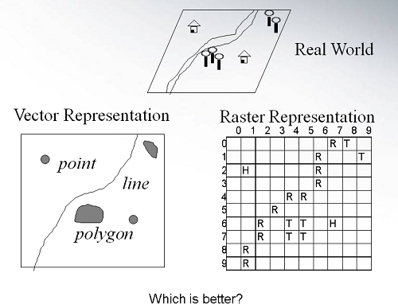
Spatial data types
Represent the real world onto a surface
Vector data: represented in points, lines & polygons
E.g. Town & city centers, rivers, roads, admin boundaries, buildings
Raster: represented as a grid of regularly sized cells or pixels
Continuous data e.g temperature distribution, elevation etc.
Notes:
Vector is represented in Points, lines & polygons
Raster – data is stored as a grid of regularly sized pixels along with attribute data. Used for continuous data

Slide 7
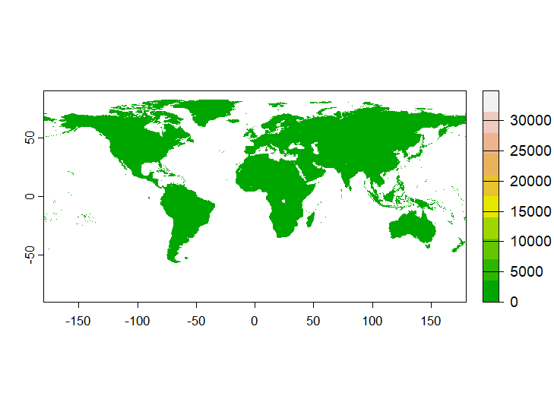
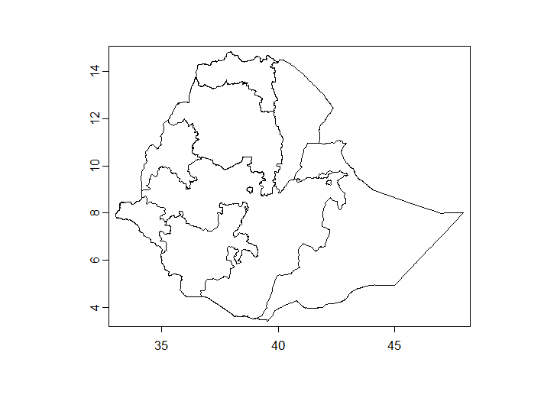
Spatial data types: vector & raster

Slide 8

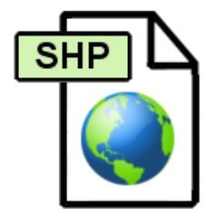
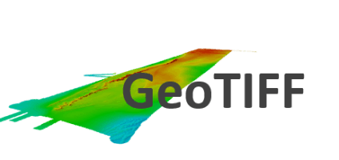
Spatial data formats
Vector
Geopackage – more recent
Esri Shapefile – most common filetype. Made of 3 mandatory files
.shp stores the feature geometry
.shx is the shape index position
.dbf is the attribute data
.prj is the projection system metadata
.xml is the associated metadata
.sbn is the spatial index for optimizing queries
.sbx optimizes loading times
Others geojson, kml etc.
Raster
GeoTIFF

Slide 9
Important Spatial Concepts

Slide 10
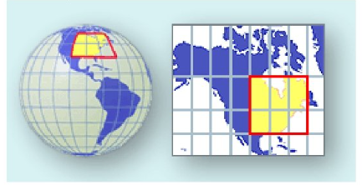
Map Projections
Method of representing part of the earth’s surface on a plane surface
Notes:
All projections have distortions
Preserve shape, area or distances

Slide 11
Coordinate Reference Systems
CRS then defines how the two-dimensional map relates to real places on the earth.
We can define CRS as systems that define how spatial data aligns with the earth’s surface
Divided into:
Geographic coordinate systems: They use degrees of latitude and longitude and describe a location on the earth’s surface. The most popular is called WGS 84. Basically, shows you where you are on earth. Units are in angular degrees
Projected coordinate system tells us how to draw on a flat surface, like on a paper map or a computer screen. Units are linear e.g metres which enables measurements
CRS are important as they ensure that data aligns correctly when overlaid.

Slide 12
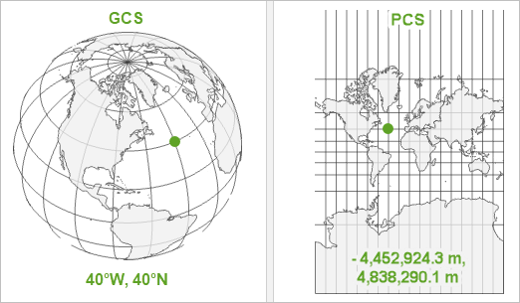
Coordinate Reference systems
If you have the same dataset saved in two different projections, these two files won't line up correctly when rendered together.
Notes:
If you have the same dataset saved in two different projections, these two files won't line up correctly when rendered together.

Slide 13
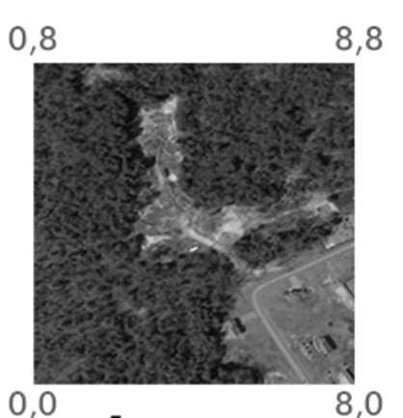
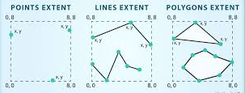
Extent
The geographic boundary/coverage of spatial data (xmin, xmax, ymin, ymax).
Determines the area covered by spatial data.

Slide 14
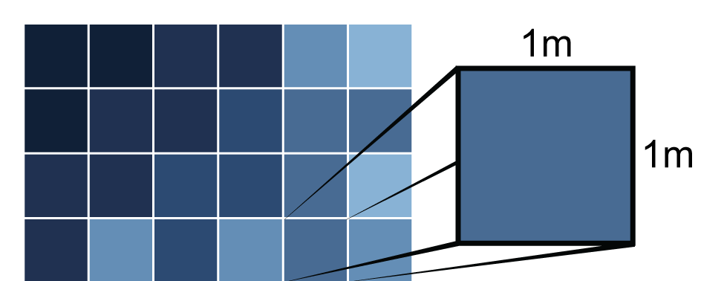
Raster Spatial resolution
The size of the area on the surface that each pixel covers is known as the spatial resolution of the image. For instance, an image that has a 1 m spatial resolution means that each pixel in the image represents a 1 m x 1 m area.
Notes:
Higher resolution = more detail but larger file size.
Lower resolution = less details

Slide 15

Raster Extent and Resolution

Slide 16
Basic Operations
Spatial data is often larger than we need it to be and we need to manipulate the data to get the desired output
And we are often only interested in the portion of that data that is located inside our study region
To get the piece of spatial data that we want for our maps or analysis we have to the select the data or crop it to our areas of interest

Slide 17
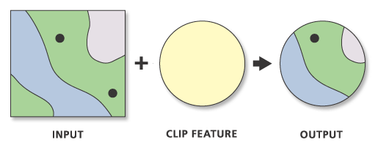
Basic Operations: Vector Clip
Notes:
Uses the cookie cutter to select features
Used commonly when defining area of interest

Slide 18
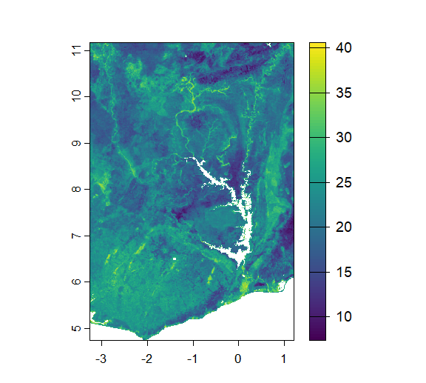
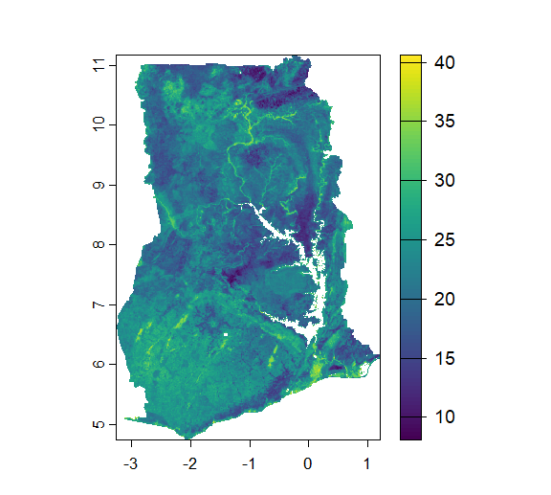
Raster Crop and Mask
Raster data is typically a large rectangular block of data so we need to crop to get to the desired output

Slide 19
R Practical Session
Rspatial libraries
terra, sf
Data sources – GADM, geodata package etc.
Reading and writing vector and raster data
Plotting spatial data

Slide 20
Resources
Materials
Design principles for cartography
Map Projections & Coordinate Reference Systems
Cropping & masking data
Data sources
GADM
Humanitarian Data Exchange
Water bodies, roads & admin boundaries
Geodata package in R
Spatial analysis in R
rspatial.org

Slide 21
Thanks!

Slide 22
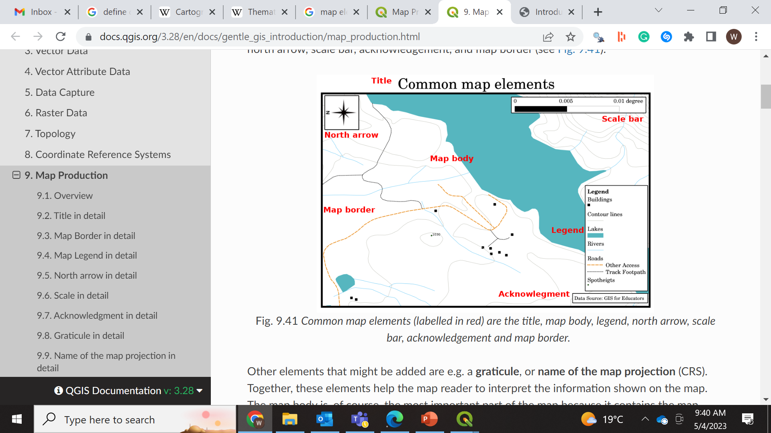
Map elements
Frame line & neat lines
Title
Map area
Insets
Legend
Data source
Scale
Map orientation
Use tmap and ggplot2 packages to create visually appealing maps
Notes:
We will only be plotting a basic map

